Slide 1
PD Nurse Specialist service during COVID-19 pandemic
support platform
13 May 2020
Time:3pm (UK Time)

Slide 2


Happy Nurses’ Day!
Save one life and you’re a hero. Save one hundred lives, & you’re a NURSE.

Slide 3
From Professor Richard Brown:
Integrating mental, physical health , depression and Anxiety course
Short course that is free and available to all.
It has been developed by KCL/KCH clinicians and academics
Aimed at a wider audience of health care professional, patients and carers. It also something that can be suggested to some of our clients.
It is fully online and can be viewed at any time while the course is open.
Participation involves about 2 hours a week for 3 weeks to complete.
There is no formal assessment.
It is also CPD accredited and a completion certificate can purchased for a small fee.
https://www.futurelearn.com/courses/integrating-mental-and-physical-health-depression-and-anxiety/1

Slide 4
Agenda:
How to resume PD service when lookdown is gradually lifted?
Sharing information and exploring options with all
Miriam Parry (King’s College Hospital, London)
Support group for PwP during covid-19 pandemic
Dr. Indu Subramanian, Neurology Specialist in Los Angeles, California. She graduated with honors in 1996. Having more than 24 years of diverse experiences, especially in neurology
Areas of interest: Integrative med and palliative care.
Co-ordinating The Center of Excellence in PD at Veteran’s Hospital and work at UCLA.

Slide 5
How to resume PD service when lookdown is gradually lifted?
NHS guidelines
Local guidelines
Patient caseload

Slide 6
Advanced therapies – steps forward?
Keep your patients in the loop!
Apomorphine
  Follow local policies
  King’s: still no green light for initiations
Duodopa
  Follow local policies
  King’s: still no green light for initiations
  When green lighted: priority given to tube replacements/maintenance of patients currently on therapy, no new initiations until current problems cleared
DBS
  Follow local policies
  King’s: no elective neurosurgeries as of yet
  Once green lighted: priority to batteries replacement/maintenance, no new patients until backlog cleared

Slide 7
Job descriptions may differ however what we all have in common is:
  The ability to act as a catalyst for change
  Potential to lead service development (phone consultation audit)
  Being a constant figure in the patient's journey
  Initiate preventative interventions
  Support self-care (Mentally and physically)
  Act as case manager
  Review/manage/prescribe medication
Availability of the nurse and their ability to respond quickly
Expert knowledge
Ability to signpost and navigate the health care system
Information-giving
PUK 2016

Slide 8

7 KEY PDNS INTERVENTIONS
Reduce /avoid hospital admissions
Prevent unnecessarily extended hospital stays (ward referrals on COVID ward ensure you have PPE? Non COVID ward mask, apron and gloves)
Reduce the need for face to face outpatient care
Help reduce outpatient waiting times (using phone clinics)
Empower and educate patients to become experts in their condition (more than ever now)
Integrate health and social care
Educate health and social care professionals about Parkinson's along the patient’s care pathway remotely

Slide 9
Parkinson’s service – Nurse led clinics
Work within your competency
Using phone consultation template
Video link consultation (ensure secure platform)
If you have been redeployed (cancelled clinics, phone calls , new referrals)
Location of clinics and maintaining quit and privacy and confidentiality while maintaining social distancing
Check that you have the admin support you need
Ensure patients are aware of latest update re Covid-19
Remember safeguarding
Referring patients and carers to Parkinson’s UK website
Research other than COVID-19-related still suspended.

Slide 10

In the Community- Home visits
Can this visit completed using remote consultation?
If not, and a visit is absolutely necessary:
Has the patient you are visiting been tested for COVID-19 and when? Are they symptomatic?
What about other members of the household?
Ensure you are given PPE
Ensure you have access to sanitizer for when donning off
Avoid taking in any of your personal items such as handbag
(take in only what you need)
Avoid using your mobile phone unless it is an emergency!

Slide 11
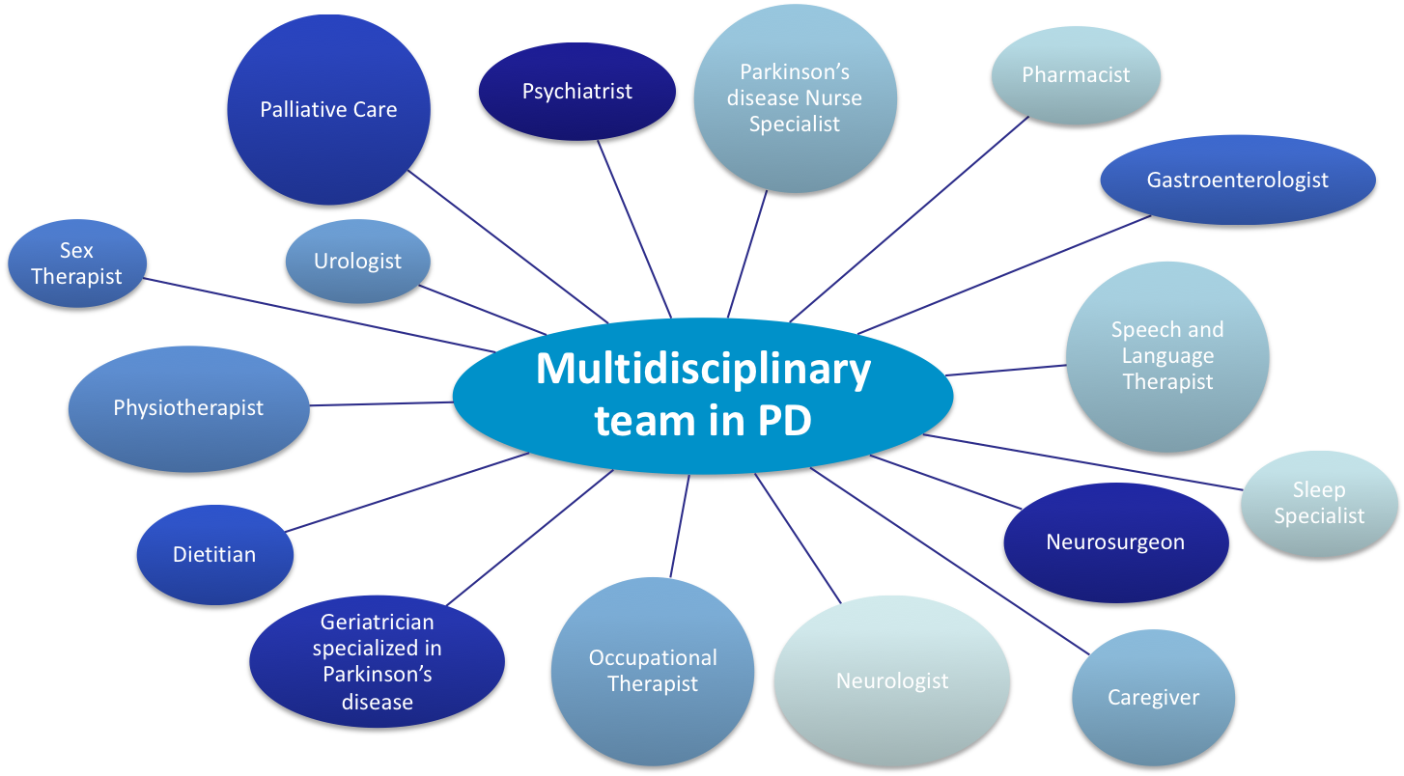
MDT- who is available?

Slide 12
Next week’s agenda
Remote assessments using clinical outcome measures and wearable sensors – where are we and how can we utilise the tools we have?
Speaker to be confirmed
Any suggestions?

