Slide 1
The Neurosurgery
SIG Meeting
Sydney 2013

Slide 2
Agenda
Neurosurgical topics for the MDS meeting in 2014
  Symposium title
  Suggested Session Chair
  The names of 3 possible speakers
  Tentative presentation titles for each speaker
Review of the actions from last year´s Neurosurgical SIG´s meeting
Review of NINDS common data elements for DBS studies (CDISC)
The SIG website
Any other business

Slide 3
Suggested Parallel Session 1
Deep brain lesioning – Back to the future
Chair: Marwan Hariz, Andres Lozano
Is there still a role for thermo-lesioning in movement disorders?
  Robert Gross, Atlanta, Georgia, USA
  Alternate Speaker: Marwan Hariz, London, UK
Gammaknife thalamotomy for tremor
  Jean Regis, Marseille, France
  Alternate Speaker: Douglas Kondziolka, New York, USA
Transcranial MR-guided focused ultrasound thalamotomy for Essential Tremor
  W. Jeff Elias, Charlottesville, Virginia, USA
  Alternate Speaker: Andres Lozano, Toronto, Canada

Slide 4
Suggested Parallel Session 2
New tools for understanding the pathophysiology of Parkinson’s Disease
  Chair: Anatol Kreitzer, Fiorella Contarino
Optogenetic dissection of basal ganglia circuits
  Karl Deisseroth, Stanford, CA, USA
  Alternate Speaker: Anatol Kreitzer, UCSF, CA, USA
Invasive electrochemical assays for use in human neurosurgery
  Kendall Lee, Mayo Clinic, MN, USA
  Alternate Speaker:Kendall Lee, Mayo Clinic, MN, USA
Local field potentials in Parkinson’s disease
  Fiorella Contarino, University of Amsterdam, Netherlands
  Alternate Speaker: Philip Starr, UCSF, CA, USA

Slide 5
Suggested Parallel Session 3
Ethical issues in DBS surgery
  Chairpersons: Jean Pierre Lin, Björn Schmitz-Luhn
Are there age limits for DBS?
  Jean Pierre Lin, King’s College Hospital, London, UK
  Alternate Speaker: Ludvic Zrinzo, Queen Square, London, UK
Law and ethics of deep brain stimulation
  Björn Schmitz-Luhn, Cologne, Germany
  Alternate Speaker: Christian Katzenmeier, Cologne, Germany
Neuroethical principles of deep-brain stimulation
  Morten Kringelbach, Oxford, UK
  Alternative Speaker: Jens Clausen, Tübingen, Germany

Slide 6
Suggested Teaching Session
How do I choose the most suitable DBS implant for my patient?
The latest developments in DBS implants
  Leo Verhagen, Rush Medical College, Chicago, IL, USA
  Alternate Speaker: Jens Volkmann, Würzburg, Germany
Matching the implant to the patient
  Paul Larson, UCSF, CA, USA
  Alternate Speaker: Paul Krack, Grenoble, France
Now it’s implanted! Approaches for the first programming session
  Elena Moro, Grenoble, France
  Alternate Speaker: Lars Timmerman, Cologne, Germany

Slide 7
Follow-up on previous SIG meetings
SIG 2011: The MDS President agreed to having a SIG member on the Congress Scientific Program Committee in time for the Sydney meeting
  Phil Starr has been on the committee
SIG 2012: A final decision made to accept the CDISC/NINDS data capture module for adverse events associated with DBS implantation
  A standard to be employed in clinical research
  Provisional standard released in December 2012 and is now available for initial use from CDISC website

Slide 8
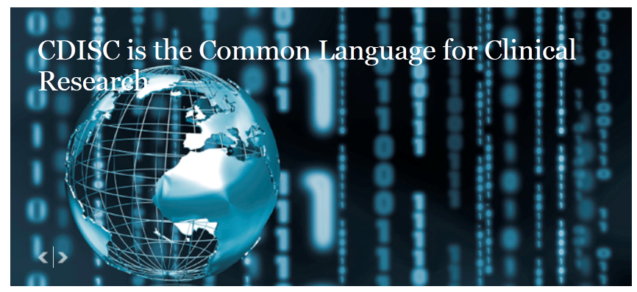
CDISC:
A global, open, multidisciplinary, non-profit organization
Establishes standards to support clinical data collection, exchange, submission and archiving
Mission:
To develop and support global, platform-independent data standards in order to improve medical research and related areas of healthcare
CDISC standards are vendor-neutral, platform-independent and freely available via the CDISC website

Slide 9
CDSIC Data Standards for PD
Intended for world-wide implementation
In collaboration with National Institute of Neurological Disorders and Stroke (NINDS)
In consultation with professional associations e.g., MDS
Includes a data collection form for DBS surgery
  Demographic data
  DBS system and stimulation parameters
  Adverse events related to implantation surgery

Slide 10
Complications of DBS surgery for PD
Nature and incidence of complications
Severity and outcome of adverse events
Association of AEs with:
  Patient demography
  Clinical status
  Concomitant medications
  Surgical target and procedure
  Hardware
  Stimulation parameters

Slide 11
Proposal for Pilot Test
A world-wide epidemiological clinical trial to:
  Test the utility of the CDISC data standards for complications associated with DBS surgery
  Explore the data for associations between various clinical parameters and the incidence of adverse events
Participating sites to enroll all consecutive patients undergoing DBS over a 1 year period
Planned deliverables
  Meeting presentations
  Publication

Slide 12
Proposal for Pilot Test (cont’d)
Next steps:
Identify interested clinical trial sites world-wide
    Each site to be responsible for local EC/IRB submission and
    associated study costs
Seek research funding to support centralized data collection and analysis
    eCRF, data management and analysis
Protocol development

Slide 13
SIG Website
New content!
  Interactive space for members to discuss patient cases
  Updates to the section on future treatments
Any volunteers?
  Authors will be recognized on the website
  A nice opportunity for residents to show their interest in the field
Please contact me with suggestions for content at
per.almqvist@ki.se

Slide 14

MDS in Stockholm 2014

